Slide 1
Professional JavaScript for
Web Development [Chapter-1&2]
PRESENTED BY:
DAW SAW THANDAR SHWE
LECTURER
ITSM DEPARTMENT
UNIVERSITY OF COMPUTER STUDIES (SITTWAY)
Information Technology Supporting and Maintenance

Slide 2
What is JavaScript?
is a dynamic language which is used for designing the web pages on the client side
works in all major browsers, such as Internet Explorer, Mozilla, Firefox, Netscape, Opera
now interacts with nearly all aspects of the browser window and Its contents
can update and change both HTML and CSS
can calculate, manipulate and validate data
is case sensitive language
is an interpreted programming language with object-oriented capabilities
Information Technology Supporting and Maintenance

Slide 3
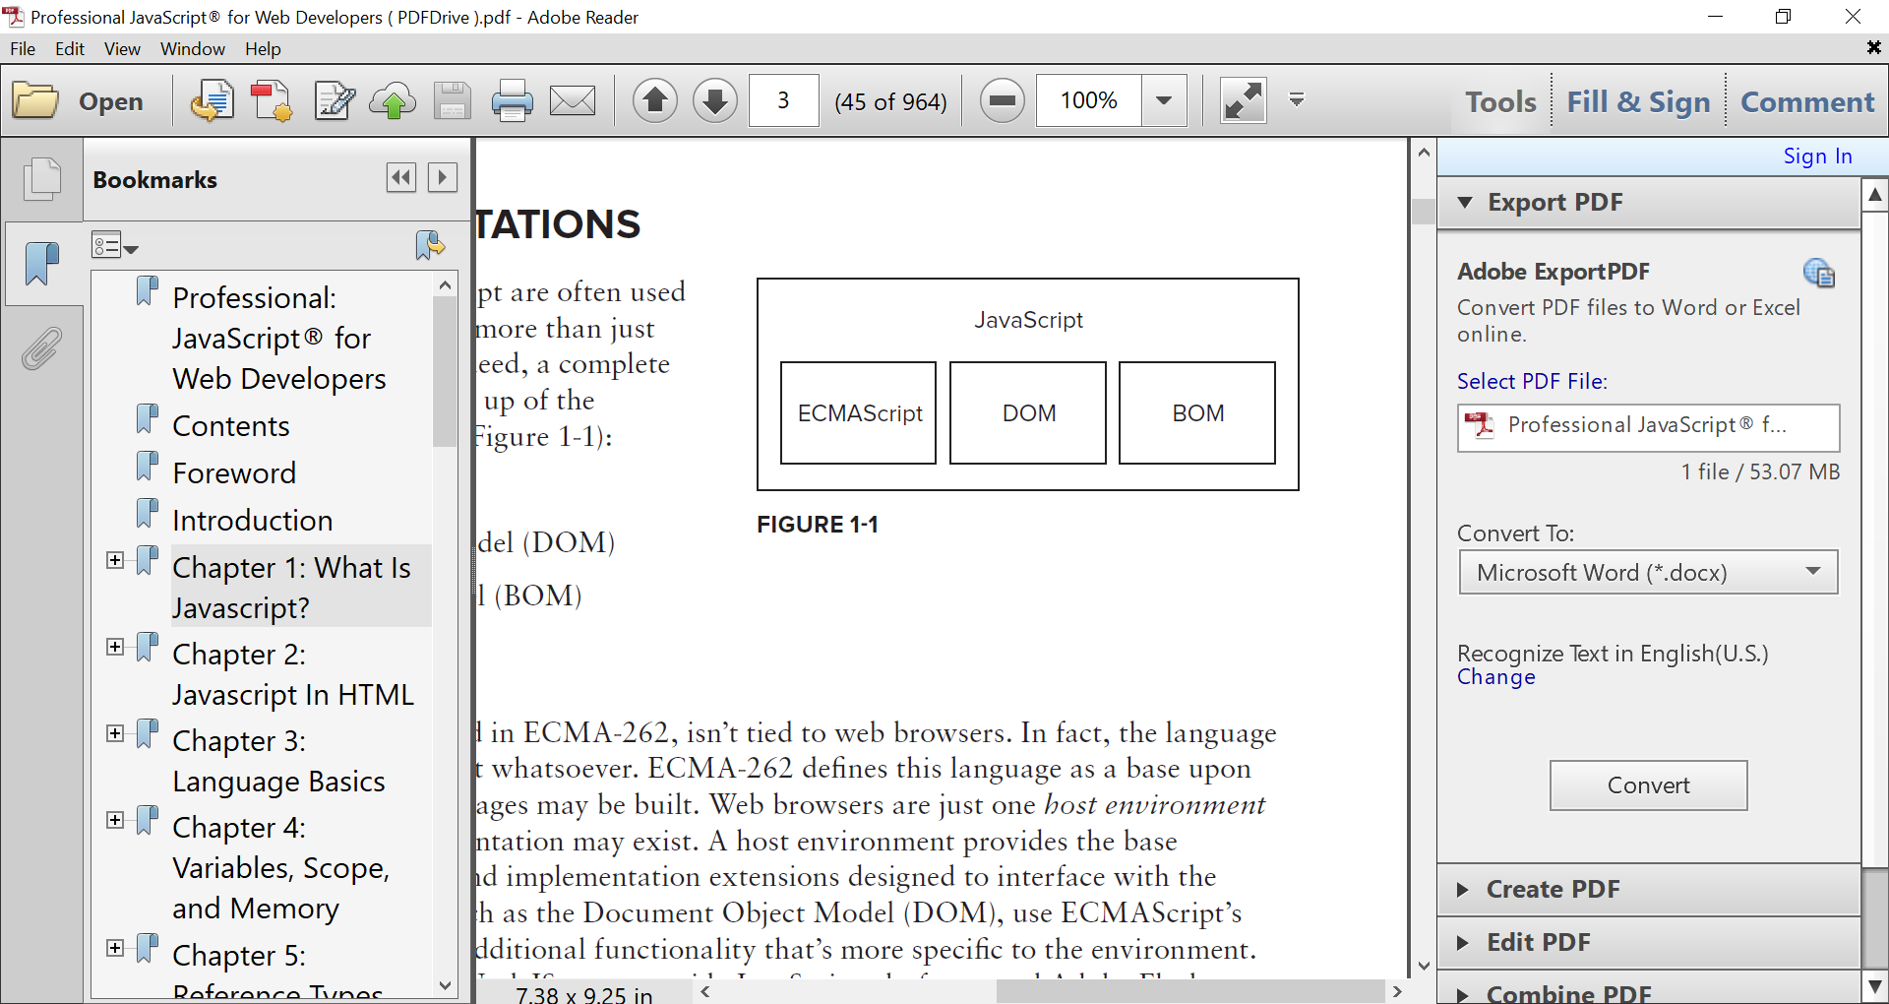
JavaScript Implementations
The Core (ECMAScript)
The Document Object Model (DOM)
The Browser Object Model (BOM)
  To run the code, you need the following:
  window XP, window 7, or mas or X
  IE6 or Chrome
  Firefox2
  Opera 9 and Safari2
Information Technology Supporting and Maintenance

Slide 4
ECMAScript
describes the following parts of the language:
  Syntax
  Types
  Statements
  Keywords
  Reserved words
  Operators
  Objects
Information Technology Supporting and Maintenance

Slide 5
Syntax of JavaScript
can be implemented using JavaScript statements that are placed within the <script>…</script> HTML tags in a web page
Syntax:
<script type=“text/javascript”>
Javascript codes
</script>
Attributes for the <script> element
type – optional: Replaces language; indicates the content type of the scripting language being used by the code block
src - optional: Indicates the external file that contains code to be executed
Information Technology Supporting and Maintenance

Slide 6
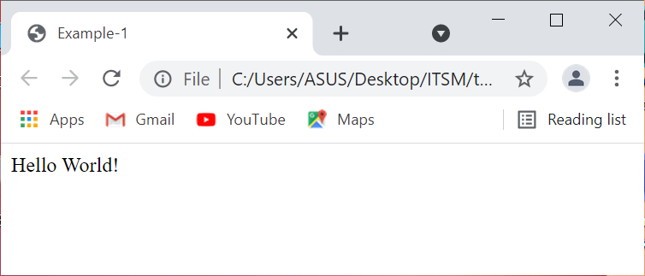
Example-1:
<!DOCTYPE html>
<html lang=“en”>
<head>
<title>Example-1</title>
<meta charset=“utf-8”>
</head>
<body>
<script type="text/javascript">
document.write("Hello World!");
</script>
</body>
</html>
Information Technology Supporting and Maintenance

Slide 7
Placement
The most preferred ways to include JavaScript in an HTML file are as follows
  Script in <head>…</head> section.
  Script in <body>…</body> section.
  Script in <body>…</body> and <head>…</head> sections.
  Script in an external file and then include in <head>…</head> section.
  Text Display
  document.write(“Hello”);
  Message Box Display
  alert(“Hello”);
Information Technology Supporting and Maintenance

Slide 8
JavaScript in <head>…</head> section
<!DOCTYPE html>
<html lang=“en”>
<head>
<title>JavaScript in head section</title>
<meta charset=“utf-8”>
<script type=“text/javascript”>
document.write (“Hello World”);
</script>
</head>
<body>
Hi!
</body>
</html>
Information Technology Supporting and Maintenance

Slide 9
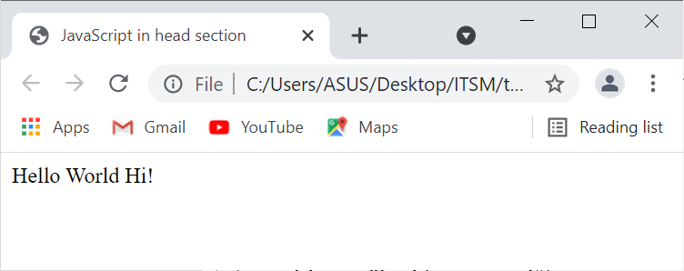
JavaScript in <head>…</head> section Output:
Information Technology Supporting and Maintenance

Slide 10
JavaScript in <body>… </body> section
<!DOCTYPE html>
<html lang=“en”>
<head>
<title>JavaScript in body section Example</title>
</head>
<body>
<script type="text/javascript">
document.write("Hello World");
</script>
<p>This is web page body</p>
</body>
</html>
Information Technology Supporting and Maintenance

Slide 11
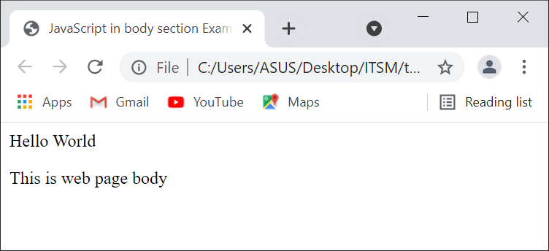
JavaScript in <body>… </body> section Output:
Information Technology Supporting and Maintenance

Slide 12
JavaScript in <body> and <head> sections
<html>
<head>
<title>JavaScript in head and body sections</title>
<script type="text/javascript">
function sayHello(){
alert("Hello World");
}
</script>
</head>
<body>
<script type="text/javascript">
document.write("Hello World");
</script>
<input type="button" onclick="sayHello()" value="Say Hello">
</body>
</html>
Information Technology Supporting and Maintenance

Slide 13
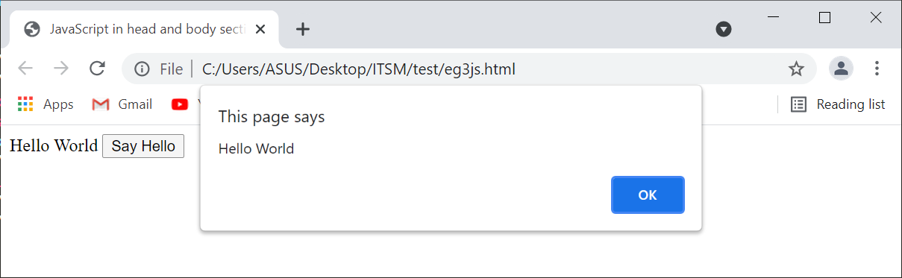
JavaScript in <body> and <head> sections Output:
Information Technology Supporting and Maintenance

Slide 14
JavaScript in External File
<html>
<head>
<title>JavaScript in External File Example</title>
<script type=“text/javascript” src=“external.js”></script>
</head>
<body>
…
</body>
</html>
external.js
========
alert(“Hello World”)
Information Technology Supporting and Maintenance

Slide 15
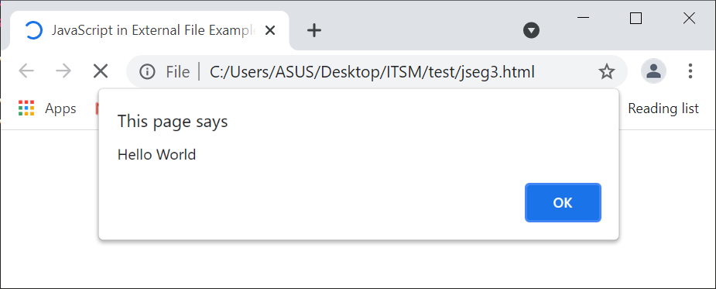
JavaScript in External File Output:
Information Technology Supporting and Maintenance

Slide 16
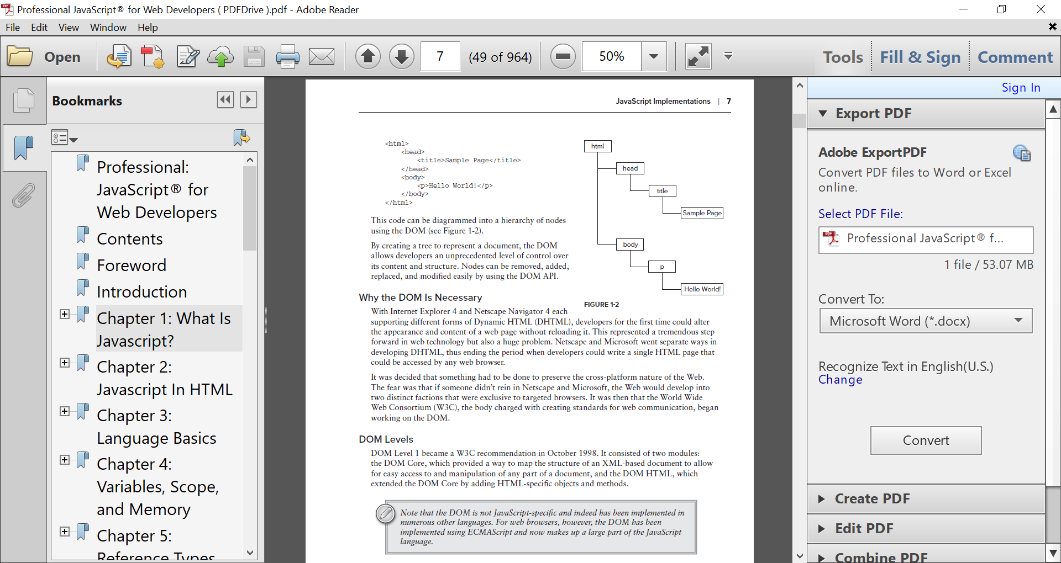
The Document Object Model (DOM)
is an application programming interface (API) for XML that was extended for use in HTML.
The DOM maps out an entire page as a hierarchy of nodes.
Each part of an HTML or XML page is a type of a node containing different kinds of data.
<html>
<head>
<title>Sample Page</title>
</head>
<body>
<p>Hello World!</p>
</body>
</html>
Information Technology Supporting and Maintenance

Slide 17
The Browser Object Model (BOM)
allowed access and manipulation of the browser window.
Using the BOM, developers can interact with the browser outside of the context of its displayed page.
The following are some such extensions:
  The capability to pop up new browser windows
  The capability to move, resize, and close browser windows
  The navigator object, which provides detailed information about the browser
  The location object, which gives detailed information about the page loaded in the browser
  The screen object, which gives detailed information about the user’s screen resolution
  Support for cookies
  Custom objects such as XMLHttpRequest and Internet Explorer’s ActiveXObject
Information Technology Supporting and Maintenance

Slide 18
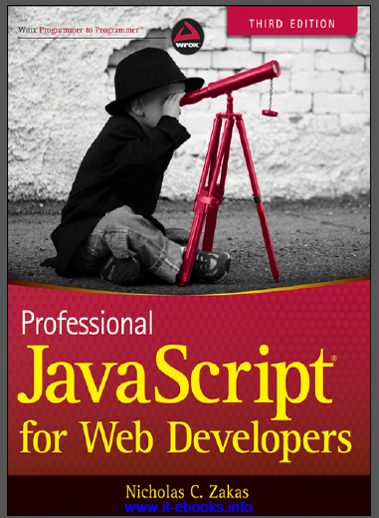
References
“PROFESSIONAL JavaScript for web Developers”
Third Edition
Zichalos C.Zakas
Nicholas, “Professional JavaScript for Web Development”
Colleen van Lent Ph.D, “INTERACTIVITY WITH JAVASCRIPT”

Slide 19
Thank You
1

